Slide 1
FAKE JOB IDENTIFICATION
PRESENTED BY
SHUBHAPRIYA GHOSH
DEPT : ADVANCED TECHNOLOGY DEVLOPMENT CENTRE

Slide 2
Problem Statement
This project aims to create a classifier that will have the capability to identify fake and real jobs. Analyze the classification using different machine learning based and deep learning based models and comparing their performances.

Slide 3
INTRODUCTION
Now-a-days, there are a lot of job scams because of unemployment. There are a lot of websites which connect recruiter to a suitable candidate.
Later, people shift to a new job portal in search of real job but the fake recruiters join this portal as well. So, it is important to detect real and fake jobs.

Slide 4
RELATED WORK
According to several studies, there is a number of works on the detection of fake jobs as well as in related topics such as detection of fake news and spam mails have drawn special attention in the domain of online fake detection.
This can be implemented by extracting features from the content machine learning models are imposed to recognize fake jobs.

Slide 5
Dataset
Real or Fake Job Posting Dataset is used in this project.
The dataset provides both textual information and numerical about the jobs. job postings are categorized as either real or fake.
The dataset consists of 17,880 observations and 18 features.
Attributes Information:
job_id , title, location ,department ,salary range, company profile ,requirements , description, required_experience, required_education, industry and function.

Slide 6
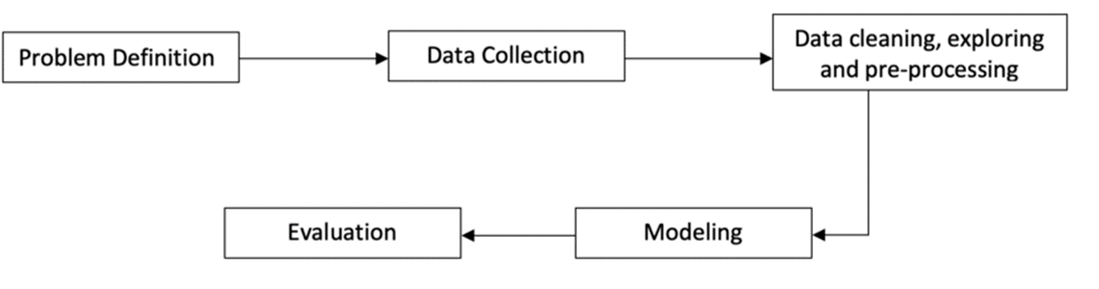
PROPOSED METHODOLOGY
This project follows five stages. The five stages adopted for this project are –
Data Collection
Data cleaning, exploring and pre-processing
Modeling
Evaluating

Slide 7
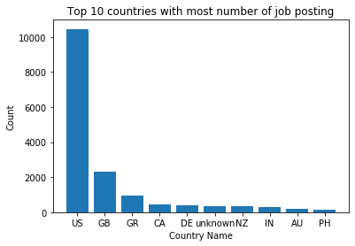
DATA ANALYSIS
It looks like most of the job postings were for jobs in US. With the great difference, GreatBritain has the second highest followed by Greece. As we did above, I would like to see the percentage of fraudlent job postings for these countries.

Slide 8
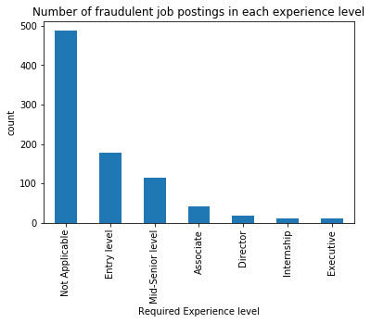
We can clearly observe that there are more number of fraudulent job posting with the experience as 'Not Applicable', this could be because we have more number of jobs in 'Not Applicable' category.
Interestingly, 'Entry_level' category has more fraudulent posting though it is 3rd highest by the number of job posting.

Slide 9
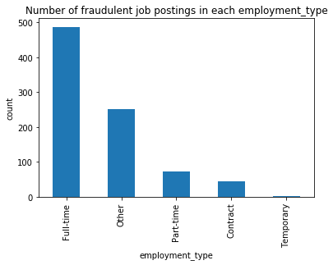
We can see that 'Full-time' jobs has the highest number of fraudulent job postings and the 'Temporary' jobs had the least number of fraudulent job postings.

Slide 10
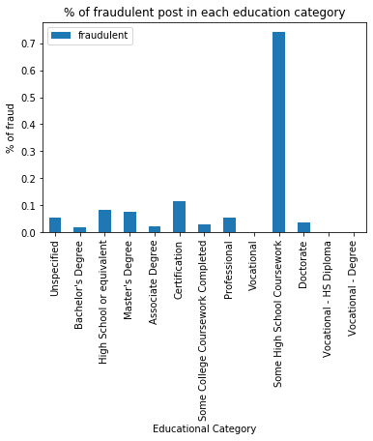
Though there are small percentage fraudulent in each category, we see that the percentage of fraudulent jobs are very high in the 'some high school coursework' category. It looks like the scammers are targeting the lower education level , as the role for lower education level could be more generic and hence its easy to define such roles.

Slide 11
Data Preprocessing
The following steps are taken for text processing:
Tokenization: The textual data is split into smaller units. In this case the data is split into words.
To Lower: The split words are converted to lowercase.
Stopword Removal: Stopwords are words that do not add much meaning to sentences. For example: the, a, an, he, have etc. These words are removed.
Lemmatization: The process of lemmatization groups in which inflected forms of words are used together.

Slide 12

Performance Evaluation Metrics
Accuracy: $Accuracy=\frac{True Positive+True Negative}{True Positive+False Positive+False Negative+True Negative}$
F1-Score: $F_{1}=\frac{True Positive}{True Positive+\frac{1}{2}(False Positive+False Negative)}$
Precision: Identifies the ratio of correct positive results over the number of positive results predicted by the classifier.
Recall: It denotes number of correct positive results divided by the number of all relevant samples.

Slide 13
Evaluation and Comparison of Machine Learning and Deep Learning Models
Various types machine learning algorithms, neural network ,bert are used in this project. Once the algorithm applied on dataset we can evaluate the performance of models and using this results we can identify fake or real jobs.

Slide 14
Performance Metrics | Logistic Regression | Random Forest | Naïve Bayes | LSTM | SVM | Decision Tree | CNN | BERT
Precision (0 and 1) | 0.96 1.00 | 0.98 1.00 | 0.97 1.00 | 0.97 0.79 | 0.95 0.00 | 0.98 0.70 | 0.97 0.97 | 0.98 0.99
Recall(0 and 1) | 1.00 0.25 | 1.00 0.50 | 1.00 0.43 | 0.99 0.52 | 1.00 0.00 | 0.99 0.61 | 1.00 0.35 | 1.00 0.68
F1-score (0 and 1) | 0.98 0.40 | 0.99 0.67 | 0.99 0.60 | 0.98 0.63 | 0.97 0.00 | 0.98 0.65 | 0.98 0.51 | 0.99 0.81
Accuracy | 0.96 | 0.97 | 0.97 | 0.97 | 0.94 | 0.96 | 0.97 | 0.98

Slide 15
Observation
In this project we have used various types of models on this dataset. But we find that some of models works very well and some does not.
By applying the classifiers we come to know that the Random Forest ,Naïve Bayes,Bert gives the better result in detecting the fake jobs compared to other models.

Slide 16
CONCLUSION
In this project we have applied machine learning , deep learning and others models which is used to classify and detect fake jobs from real jobs in a large dataset of job posts.
After analyzing these performances, we conclude that having global knowledge of the dataset helps the model in preventing jobs.

Slide 17
REFERENCES
Shwani, D., & Samir, K.B. (2020). Fake Job Recruitment Detection Using Machine Learning Approach. International Journal of Engineering Trends and Technology (IJETT).
Shivam Bansal (2020, February). [Real or Fake] FakeJobPosting Prediction,Version 1.Retrieved March 29,2020 https://www.kaggle.com/shivamb/real-or-fake-fakefakejobposting-
Prediction.

Slide 18
THANK YOU

